Slide 1

PCHS Academics
Diploma Paths
Requirements
Graduation Pathways

Slide 2
Welcome!
High School Guidance Counselors:
Amanda Peterson and Carrie Engelbrecht
Deena Gibson, Director

Slide 3
Diploma Paths
Core 40 (40 credits)
Academic Honors (47 credits)
Technical Honors (47 credits)

Slide 4
What is a credit?
How do I obtain credits?
Pass a one-semester class = earn 1 credit
Can earn 7 credits per semester = 14 per year
You must obtain credits in progression in order to advance to next grade level.

Slide 5
Core 40 Requirements
English (4 years): English 9, 10, 11, 12
Math (min. 3 years): Must earn 6 math credits during high school despite math credits earned at PCMS: Algebra, Geometry, Algebra II, Pre-Calculus, Trigonometry, Probability & Statistics, AP Calculus

Slide 6
Core 40 Requirements (cont.)
Social Studies (3 years): World History, US History, Government/Economics
Science (3 years): 1 year of Biology, 1 year of Chemistry, Physics, or ICP, and 1 additional year of any science class offered
Foreign Languages: Not required but highly recommended to take one or two years for better college preparation.

Slide 7
Academic Honors
(Requirements in addition to the Core 40)
47 credits, Minimum GPA 3.0, earn C- or higher in all required classes
Earn 2 additional math credits
Earn 6 credits in a foreign language or 4 credits in two different languages (8 credits)
Earn 2 fine art credits
Obtain 1 of the following: 6 dual credits, 4 AP credits, 3 dual credits and 2 AP credits, 26 score on ACT, or 1250 score on SAT

Slide 8
Technical Honors
(Requirements in addition to the Core 40)
Can be paired with Academic Honors
Earn 6 Career-Technical Credits in addition to required courses for Core 40 or AH track (*6 CTE credits must be in an approved CTE pathway)
Earn 6 CTE Dual Credits from approved list (need 12 if also on AH path) OR earn an industry-based certification
Must achieve a “C-” or higher in each course
47 Credits required & must achieve a “B”(3.0) overall GPA
2 credits in Foreign Languages recommended

Slide 9
Tech Honors
Helpful Tips
If you are interested in possibly pursuing a career that is industrial/technology based, you may want to enroll in one of the following as freshman:
  Introduction to Machine Tools ( 2 periods/one semester); dual credit
  Intro. to Agriculture or Ag. Power Structures & Tech.; dual credit
  Intro to Communication, Construction, and/or Transportation (each 1 semester)
  Intro to Engineering (dual credit)
  Intro to Manufacturing
  If interested in 4T, take a technical course.
Also, consider taking Spanish or Latin if you have room in your schedule and/or have not yet decided you are going to do Academic Honors.

Slide 10
Required for all students
PE (2 semesters); 1 PE credit can be earned with 1 season of a sport or marching band
Health (1 semester)
Speech (1 semester)
Preparing for College & Careers (1 semester – taken at PCMS)

Slide 11
Example of 9th grade
Core 40 Schedule
Algebra
Concert Band
English 9
Biology
PE/Health
Into to 2D Art/Intro to 3D Art
Intro to Engineering

Slide 12
Example of 9th Grade
Academic Honors Schedule
Geometry (Honors or Regular)
English 9 (Honors or Regular)
Biology
Principles of Biomedical Science
Health/PE
Spanish I or Latin 1
Intro to Art

Slide 13
Example of 9th Grade
Tech Honors Schedule
Algebra
English 9 (Honors or Regular)
Biology
Spanish I
Term 1: Intro Machine Tools, 2 period class for 1 semester
Term 2: Intro to Communication/Intro to Construction
PE/Strength

Slide 14
Example of Band with
AH or TH Schedule
English 9 (Honors or Regular)
Geometry (Honors or Regular)
Biology
Health/PE
Latin I
Concert Band (Counts as Fine Arts Credit)
Introduction to Agriculture

Slide 15
Honors Weighted grades
(0.01 add-on)
After GPA is computed each semester, students in the following classes will earn 0.01 add-on credit each semester to compute their weighted GPA
English 9 Honors
English 10 Honors
English 11 Honors
Advanced Composition, English Literature (Eng. 12 Honors), Adv. Speech
Geometry Honors, Algebra II Honors, Pre-Calculus/Trigonometry Honors
Economic Honors, Government Honors
Anatomy & Physiology, Chemistry II

Slide 16
AP Weighted Grades
(0.02 add-on)
After GPA is computed each semester, students in the following classes will earn 0.02 add-on credit each semester to compute their weighted GPA
AP Biology
AP Language
AP Literature
AP Calculus AB
AP Calculus BC
AP US History
AP Spanish
Organic/Biochemistry

Slide 17
Graduation Pathways
3 steps to meet requirements
  Earn a high school diploma
  Learn and demonstrate employability skills
  Satisfy postsecondary-ready competencies

Slide 18
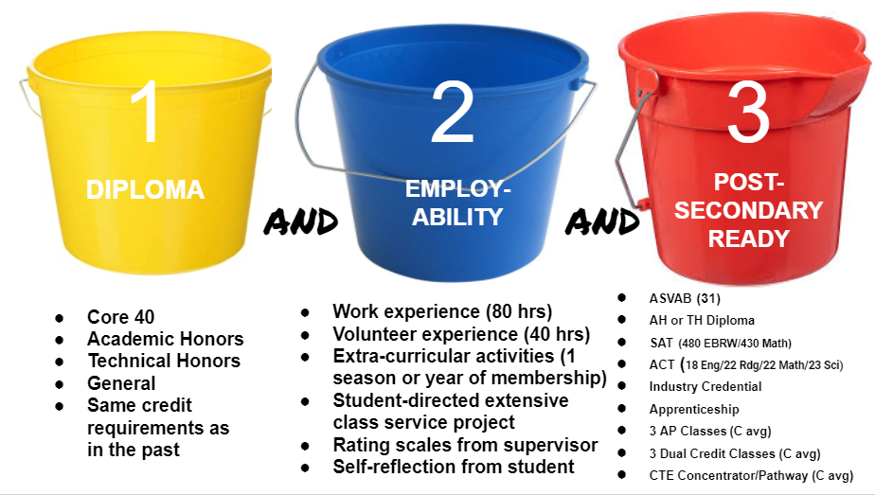

Slide 19
Your school counselors are here to help!
Mrs. Peterson (students with last names A-J)
Mrs. Engelbrecht (students with last names K-Z)
Mrs. Montgomery, Youth First Social Worker
Mrs. Gibson, Director of Guidance

Slide 20

Follow Us!
http://ngsc.k12.in.us/guidance-department
Facebook: “PCHS Tigers School Counseling Department”
Remind app: Text @b8fa4c to 81010 to receive 9th grade remind alerts
on your phone
(other grade level invite codes will be
sent home with students)

